Slide 1
Tunnelling Association of Canada
Equity, Diversity, and Inclusion Moment
Indigenous Land Acknowledgement

Slide 2
Tunnelling Association of Canada
Why is indigenous land acknowledgment important?
“It is important to understand the longstanding history that has brought you to reside on the land, and to seek to understand your place within that history. Land acknowledgements do not exist in a past tense, or historical context: colonialism is a current ongoing process, and we need to build our mindfulness of our present participation.”
– Northwestern University
2

Slide 3
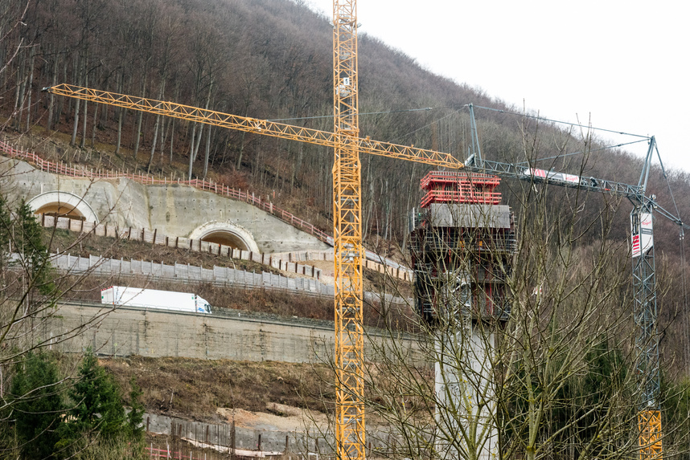
Tunnelling Association of Canada
Tips for creating a land acknowledgment
Reflect on why you are doing a land acknowledgement
Research the Indigenous people to whom the land belongs
Practice the correct pronunciation of the names of the Tribes, Nations, or bands, and places and individuals you are including in the acknowledgement
Use past, present, and future tenses
5

Slide 4
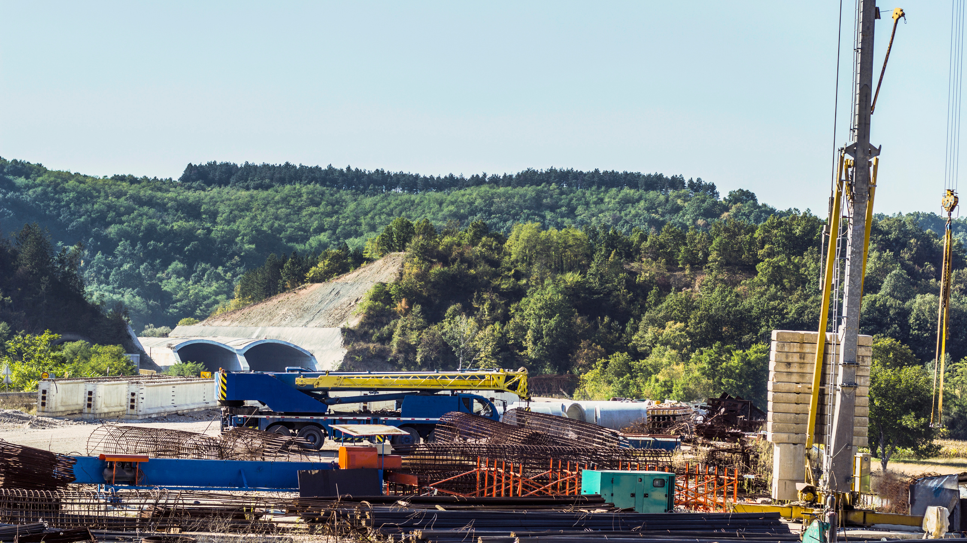
Tunnelling Association of Canada
Example
3

Slide 5
Tunnelling Association of Canada
Date
Thank you!
The End

